Slide 1
A Web-based Simulation Platform
Supervisor: Gabriel Wainer
By: Tyler Mak (101108389) and Andy Ngo (101132278)
Project ID: 50
Notes:
Location: ME4359
COVID is no longer in the title because the simulation just focuses on multiple models, and not just covid.

Slide 2
Introduction
Modeling, Simulation, & Web-based Simulation
Project Description
Problem
Goal
Solution
About Websockets
Demo
Future Plans
Conclusion

Slide 3
Modeling, Simulation & Web-based Simulation
Modelling: use of physical or logical representation of a given system to generate data and help determine decisions / make predictions about the system
Simulation: helps analyze the performance of an existing or proposed system
Runs and generates log files
End user has to use their own tool to analyze or visualize
Web-based Simulation: integration of web services within the field of simulation to properly implement on the web
Easier for the end user
What is modeling and simulation (M&S)? | Definition from TechTarget. (2017, September 16). WhatIs.com. https://www.techtarget.com/whatis/definition/modeling-and-simulation-MS
Modelling & simulation tutorial. (n.d.). Online Tutorials Library. https://www.tutorialspoint.com/modelling_and_simulation/i
What is web-based simulation. (n.d.). IGI Global: International Academic Publisher. https://www.igi-global.com/dictionary/application-of-cloud-based-simulation-in-scientific-research/38992

Slide 4
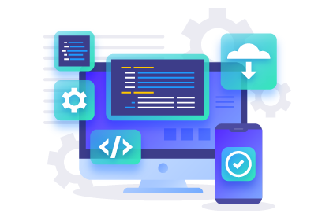
Project Description
Web based application that performs use case specific simulations using simulation models

Slide 5
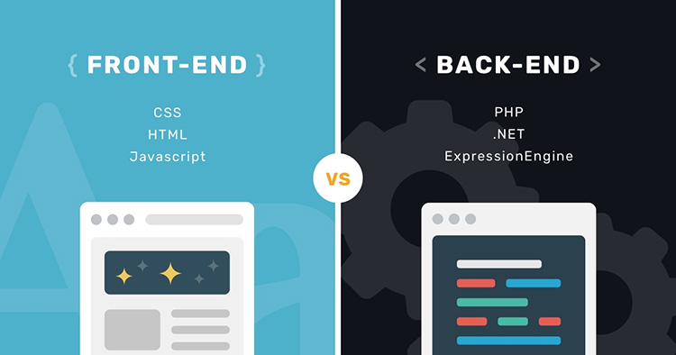
Project Description Continued
Front-end of the system is the web viewer
takes simulation input
renders simulation result visuals
Back-end of the system uses Cadmium simulator
Generate simulation results
Communication of front and back end is done through REST architecture
REST is one-way communication

Slide 6

Problems
Current web simulation is difficult
Simulation computationally expensive
Designing models and experiments are complicated for non-experts

Slide 7
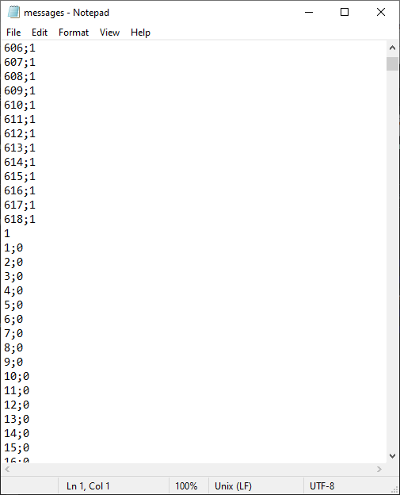
Problems Continued…
Backend stores simulation results in a log file
Each user will have their own log file
Simulation results transferred as one entire log file
Simulation visualization only start after the entire log file is downloaded on the frontend

Slide 8
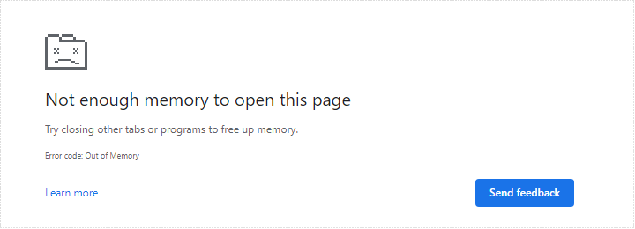
Problems Continued…
Frontend performance deteriorates
Not enough memory in browser
Must wait for entire log file

Slide 9
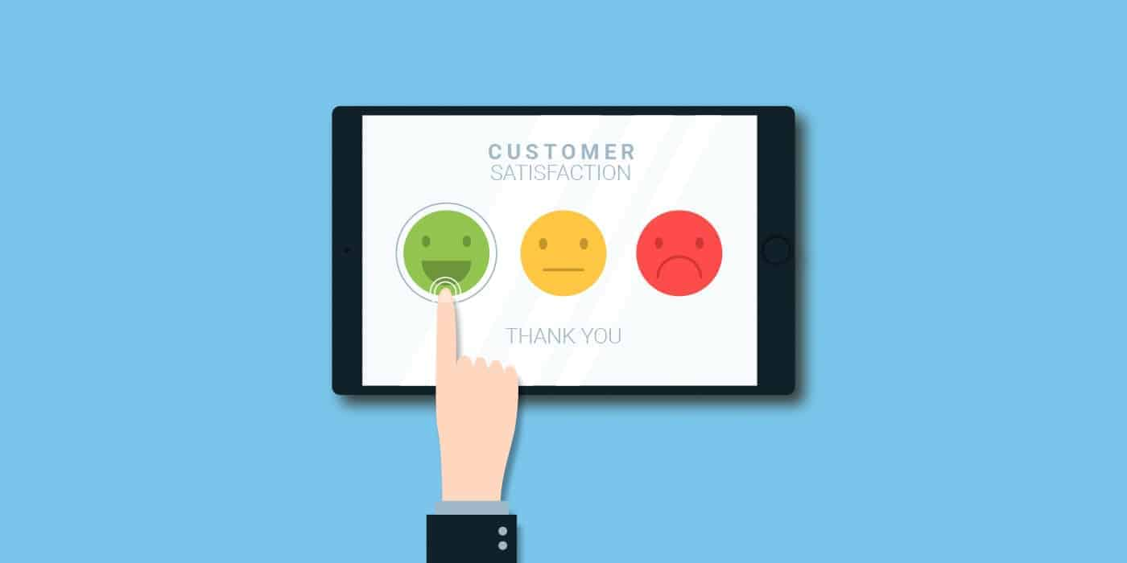
Goal
Improve user experience
Make it easier to use
Faster
Provide visualization of simulation results

Slide 10
Goal Continued...
Make opportunity to build better web simulation applications
Not many known web environments that do this

Slide 11
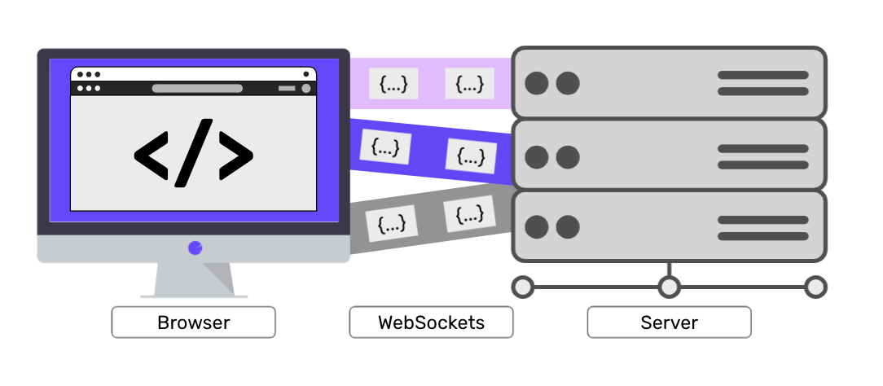
Solution
Using Websockets
Stream the result data as time frames (one step in the simulation)
Simulation will begin after the first time frame is received
Visualize results as simulation executes
Implement interactive simulation (stop simulation, change parameters, resume simulation)

Slide 12
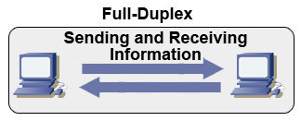
Websocket Introduction
Provides full-duplex communication
Allows clients and servers to communicate to one another
Does not need polling
Connection continues until either client or server terminates
What is web socket and how it is different from the HTTP? (2022, February 21). GeeksforGeeks. https://www.geeksforgeeks.org/what-is-web-socket-and-how-it-is-different-from-the-http/
WebSockets vs Long Polling | Ably Blog: Data in Motion. (2023). Retrieved 26 January 2023, from https://ably.com/blog/websockets-vs-long-polling#:~:text=Long%20polling%20is%20more%20resource,hops%20between%20servers%20and%20devices.

Slide 13
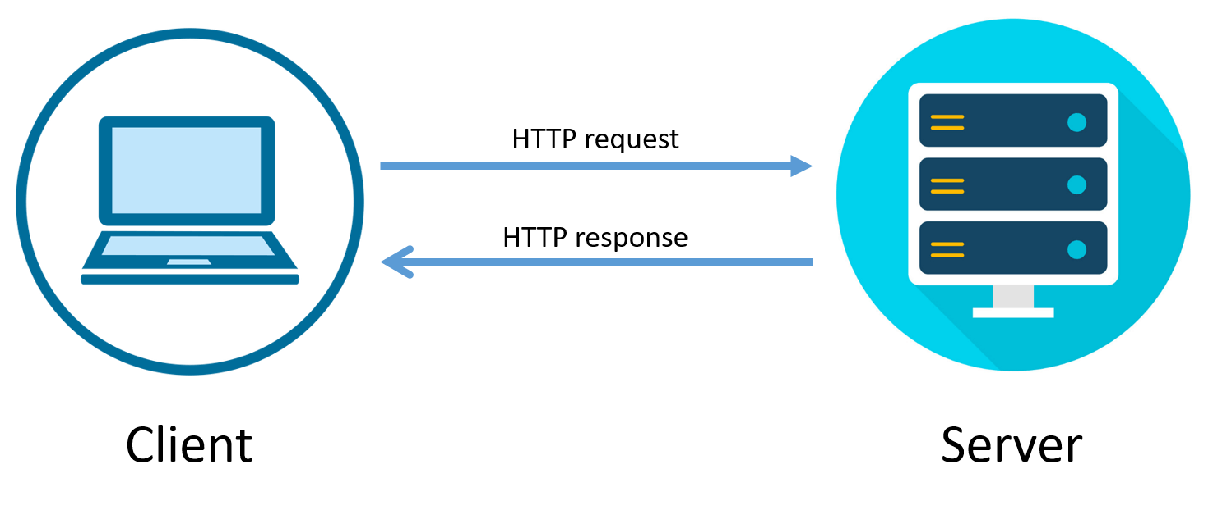
Websockets Continued…
Comparing to HTTP Connection:
Less resource intensive
Reduced latency
Headers are not sent, therefore size is reduced

Slide 14
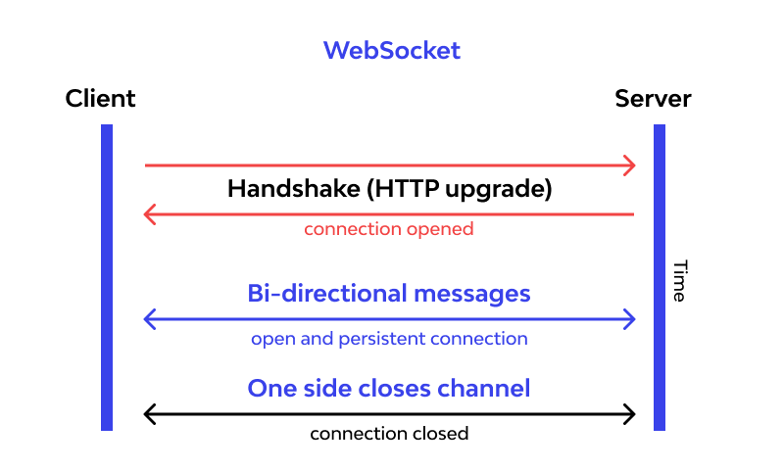
Websockets Continued…
Used to optimize streaming simulation results
Ideal method because if we were to have the client pull requests it is more resource intensive
[1] What is WebSocket and how it works? ⚙️. (2023, January 20). End-to-end API Security for Cloud-Native Applications ☁️ - Wallarm. https://www.wallarm.com/what/a-simple-explanation-of-what-a-websocket-is

Slide 15
Cadmium Software Aspect
Object-oriented implementation of PDEVS simulator using C++ 17
Is a header-only library
Used for simulating and implementing PDEVS, classic Cell-DEVs, and an asymmetric Cell-DEVS model

Slide 16
SockJS and STOMP
SockJS is a javascript library that creates a websocket-like object
Javascript API which creates communication channel between browser and web server
Tries native websocket first then browser specific transport protocols
STOMP (Simple Text Oriented Messaging Protocol)
Frame based protocol modelled on HTTP
Uses heartbeat to connect client to server
Frames we use: CONNECT, CONNECTED, SUBSCRIBE, SEND, MESSAGE, DISCONNECT
SockJS creates a socket on both the frontend and backend, STOMP is the protocol used to communicate between the two sockets
STOMP Protocol Specification, Version 1.2. (n.d.). https://stomp.github.io/stomp-specification-1.2.html
SockJS-client. (n.d.). https://github.com/sockjs/sockjs-client

Slide 17
Demonstration - Original Streaming
https://devs-simulators.sce.carleton.ca/CD++/Cell-DEVS/#model
Notes:
Here we will be demonstrating the original simulation

Slide 18
Demonstration - Websocket Streaming
Notes:
Now to show the streaming of the simulation results with websockets,
Go through code
Start the connection
Open localhost

Slide 19
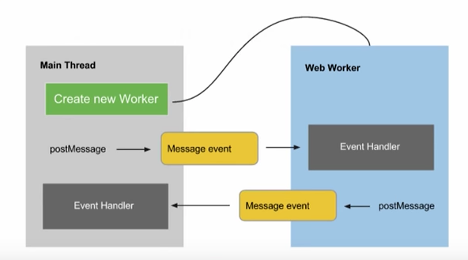
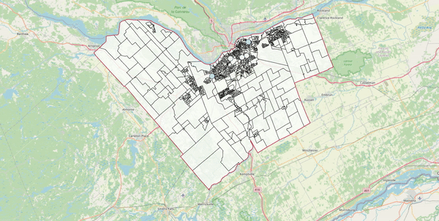
Future Plans
Integrate the visuals to go along with the simulation results streaming
Integrate webworkers into the front end
Will help with bigger log files
Replace SockJS and STOMP with Native Websockets

Slide 20
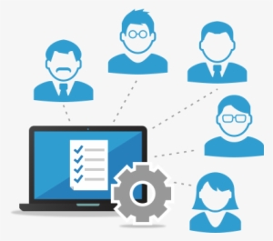
Future Plans Continued…
Allow multiple users to access same log file
Implement interactive simulation

Slide 21
Conclusion
The original system took up too much memory and was slow
Websockets stream the results faster without using as much memory and allow for simulation to start as soon as possible
Web-based simulation platform will make it easier to access
It will be useful for future plans
Notes:
To conclude the presentation
adding in websockets into the system have improved the simulation results streaming,
Plan to implement the visuals to go along with the simulation results next
We plan to add webworkers to the system to make it more efficient overall with bigger files
Change the websockets to be native websockets to work with webworkers
The next big plan for this project is to allow users to interact with the simulation

Slide 22

Questions?

